Slide 1
BASIC PROFESSIONAL TRAINING COURSE
Module 21-P2
Name of Lecturer
Organization
Email address

Slide 2
BASIC PROFESSIONAL TRAINING COURSE
Leadership, Management for Safety and Safety Culture
Leadership for Safety
This material was prepared by the IAEA and co-funded by the European Union.

Slide 3
Contents
SF
GSGs
SSRs
GSGs
SSG
IAEA Approach
Concept of Leadership for Safety
Leadership Roles and Responsibilities
Vision for managing growth of and change in the organization
07-18 May - 18-29 June 2018

Slide 4
Learning objectives
Leadership for Safety
After completing this chapter from Module 21, the trainee will be able to understand:
IAEA safety standards relevant to Leadership for Safety requirements
Basic concept of Leadership and management
Leadership responsibilities
Leadership vision for managing growth of and change in the organization
07-18 May - 18-29 June 2018

Slide 5
IAEA Approach
Notes:
A clear policy, vision, strategy, plans and objectives should be developed and communicated frequently and consistently. To develop a good understanding, senior managers should communicate the beliefs that underlie the organization’s policies through their own behaviour and management practices. Leaders at all levels in the regulatory body show commitment to continuous improvement.
Goals: an aim, or desired result
Strategies: a plan of action designed to achieve a long-term or overall aim
Plans: a detailed proposal for doing or achieving something
Objectives: a thing aimed at or sought; goal
Safety policy: a course or principle of action adopted by an organization or individual
Senior management: the person who, or group of people which, directs, controls and assesses an organization at the highest level

Slide 6

Fundamental Safety Principles
Principle 3: “Effective leadership and management
for safety must be established and sustained in
organizations concerned with, and facilities and
activities that give rise to, radiation risks.”
  Leadership in safety matters has to be demonstrated at
  the highest levels in an organization as well as demonstrated at all other levels in the organization
  Leadership aims at achieving commitment to goals, shared values and behaviours that influences and motivates individuals and organizations to continually improve performance. A Leader influences on the thoughts, attitudes and behaviour of others
  Leaders take responsibility for their actions and hold others responsible for theirs.
07-18 May - 18-29 June 2018
Notes:
Also refer to GSR Part 2, Req. 2
This principle also applies to regulatory body

Slide 7
Fundamental Safety Principles
Lesson-learned from Fukushima
  (SF-1) Prime responsibility for safety rests with Licensee. However, at an international level, all eyes looked to the regulatory body for answers on how this could have happened
  Regulatory body mandate and accountability is to regulate safety for achieving fundamental safety objective
Keys to meeting this challenge as a regulatory body:
  Ensure that the legal and regulatory framework is in place
  Maintain high degree of confidence by ensuring safety
  Use a systemic approach Safety is the result of interaction between Individual, Technology and Organization (ITO)
  Need for effective Leadership, safety culture and management system to ensure proper management for safety
07-18 May - 18-29 June 2018
Notes:
With a systemic approach to safety that analyses the individual, organisational and technical factors, and organization (ITO) can be better prepared for an unexpected event.” “Expert form the behavioural sciences, and the related research, needs to be better utilized in the effort to understand and apply a systemic approach to safety”
A systemic approach to safety means that we comprehend the whole systems interplay between individuals, technology and organization
The whole system is too complex for one individual to comprehend, an integrated approach is needed to invite different competencies and thinking
Understanding the dynamics of the ITO helps us to evaluate their ability to produce safety outcomes more effectively
Safety outcomes emerges from ITO interactions
The systemic approach to safety capitalizes on understanding the strengths as well as the vulnerabilities in all factors influencing nuclear safety (Human and organizational factors which affect the performance at work)

Slide 8
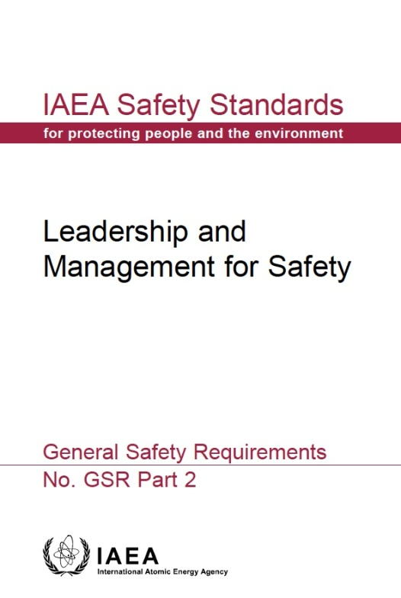
GSR Part 2 Leadership & Management for Safety
R1: Achieving the fundamental safety objective
Responsibility for Safety
Responsibility for Integration of Safety into the Management System
R2: Demonstration leadership for safety by managers
Leadership for Safety
Culture for Safety
R12: Fostering a culture for safety
Management for Safety
R3: Responsibility of Senior Management for the Management System
Measurement, Assessment and Improvement
R13: Measurement, assessment and improvement of the management system
R4: Goals, strategies, plans and objectives
R14: Measurement, assessment and improvement of the management system
R5: Interaction with interested parties
Management of Processes and Activities
R6: Integration of the Management System
R7: Application of the Graded Approach
R8: Documentation of the Management System
The Management System
Management of Resources
R9: Provision of Resources
R10: Management of Processes and Activities
R11: Management of the Supply Chain
Management of Processes and Activities
07-18 May - 18-29 June 2018
Notes:
2. RESPONSIBILITY FOR SAFETY
Requirement 1: Achieving the fundamental safety objective
3. LEADERSHIP FOR SAFETY .
Requirement 2: Demonstration of leadership for safety by managers
4. MANAGEMENT FOR SAFETY
Responsibility for integration of safety into the management system
Requirement 3: Responsibility of senior management for the management system
Requirement 4: Goals, strategies, plans and objectives
Requirement 5: Interaction with interested parties
Requirement 6: Integration of the management system
Requirement 7: Application of the graded approach to the management system
Requirement 8: Documentation of the management system
Management of resources
Requirement 9: Provision of resources
Management of processes and activities
Requirement 10: Management of processes and activities
Requirement 11: Management of the supply chain
5. CULTURE FOR SAFETY
Requirement 12: Fostering a culture for safety
6. MEASUREMENT, ASSESSMENT AND IMPROVEMENT
Requirement 13: Measurement, assessment and improvement of the management system
Requirement 14: Measurement, assessment and improvement of leadership for safety and of safety culture

Slide 9
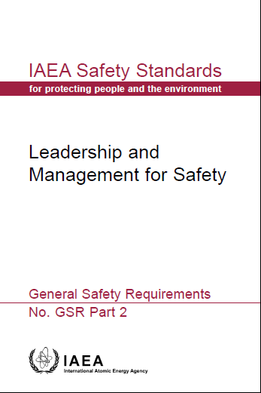
GSR Part 2: Leadership for Safety
Req. 1: Achieving the Fundamental Safety Objective
Leadership for safety and management for safety are to be developed together and integrated so that all individuals in an organization are involved and are committed to safety and regulatory performance
Achieving the fundamental safety objective
Leadership for Safety
Process Implementation
Measurement, Assessment and Improvement
Responsibility of Management
Management of Resources
Effective management for safety
Proper consideration of ITO
Safety Culture
07-18 May - 18-29 June 2018
Notes:
GSR Part 2 scope has been extended to cover the ‘three pillars’ of Management for Safety: Leadership for Safety; Safety Culture; Effective Management System

Slide 10
GSR Part 2: Leadership for Safety
Requirement 2: Demonstration of leadership for
safety by managers
Managers shall demonstrate leadership for safety and
commitment to safety
3.1. The senior management of the organization shall
demonstrate leadership for safety by:
(a) Establishing, advocating and adhering to an organizational approach to safety - as an overriding priority….
(b) Acknowledging interactions between people, technology and the organization (ITO)
(c) Fostering a strong safety culture
Establishing responsibilities and accountability for safety for all individuals in the organization and establishing that decisions taken consider safety as priority
07-18 May - 18-29 June 2018

Slide 11
GSR Part 2: Leadership for Safety
3.2. Managers at all levels in the organization, taking into account their duties, shall ensure that their leadership includes:
Setting goals for safety consistent with safety policy
Setting responsibilities and authorities of all individuals at all levels
Demonstrating commitment to improving safety performance
Development of individual and institutional values and acting as role models;
Develop questioning and learning attitudes
3.3. Managers at all levels in the organization shall:
(a) Encourage and support individuals in achieving safety goals and performing their tasks safely
(b) Engage all individuals in enhancing safety performance
(c) Communicate clearly the basis for safety related decisions
07-18 May - 18-29 June 2018

Slide 12
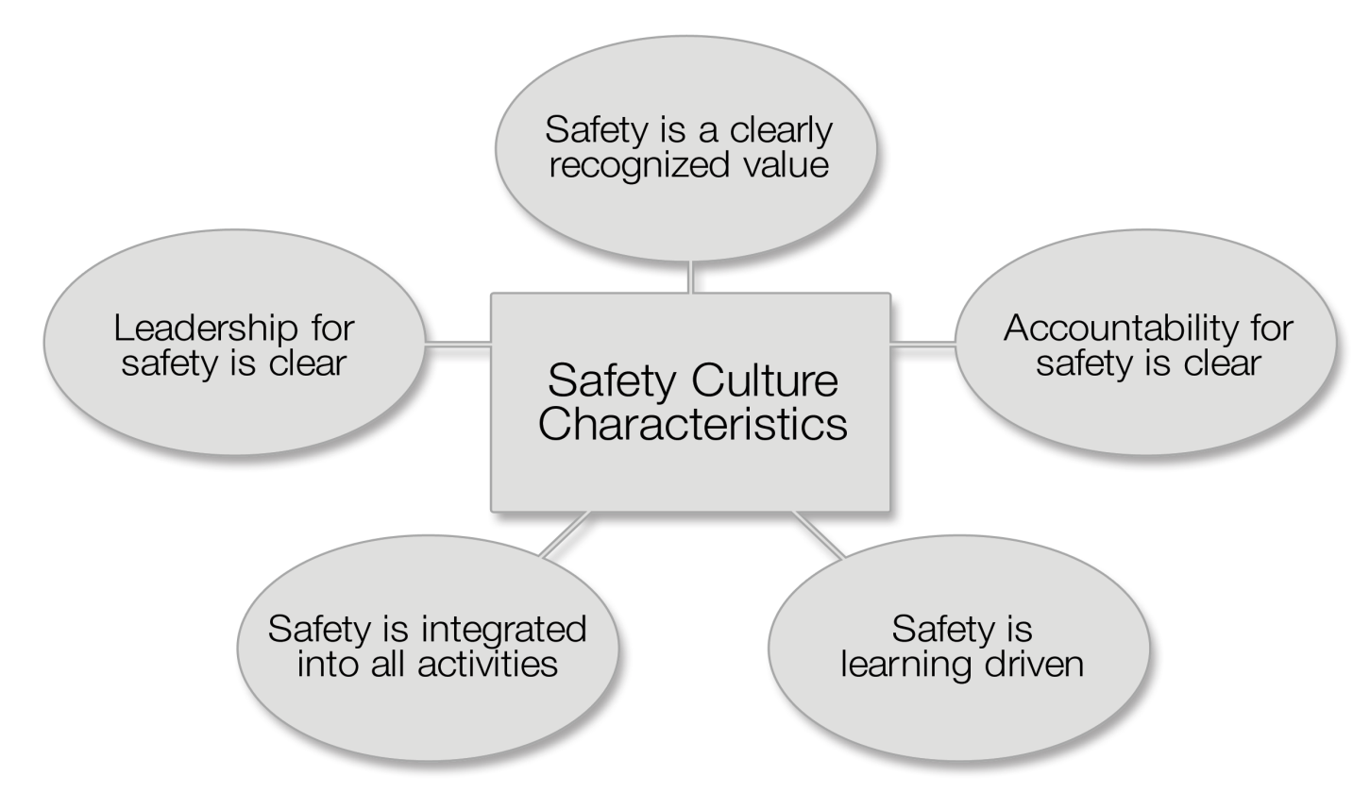
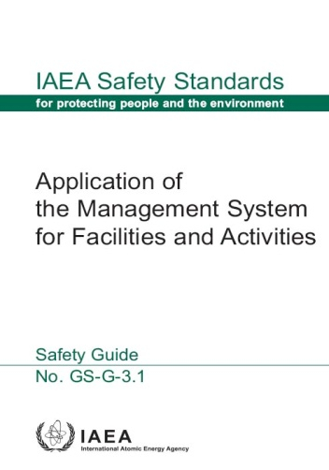
Safety Culture characteristics and attributes
Commitment to safety by senior management
Commitment to safety is evident at all management levels
Visible leadership showing involvement of management in safety related activities
Leadership skills are systematically developed
Management assures that there is sufficient and competent staff
Management seeks the active involvement of staff in improving safety
Safety implications are considered in the change management process
Management shows a continuous effort to strive for openness and good communications throughout the organization
Management has the ability to resolve conflicts as necessary
Relationships between management and staff are built on trust
General Safety Guide GS-G-3.1
07-18 May - 18-29 June 2018
Notes:
12
Leadership for Safety is one of the key characteristics will support Culture for Safety

Slide 13
SSG-16: Leadership for safety
  SSG-16 Actions 72-84 provide recommendations for building of leadership and management for safety and of a safety culture amongst the involved organisations in nuclear power programme
Ready to make a knowledgeable commitment to a nuclear programme
Ready to invite bids
Ready to commission and operate the first NPP
Phase 1
Phase 2
Phase 3
Role of the Government
Action 72, 74
Implementation of the Regulatory Body
Action 78, 82
Action 75, 76
Implementation of the Operating Organization
Action 78, 82
Action 75, 76
M1
M2
M3
07-18 May - 18-29 June 2018
13
Notes:
The picture shows the role of the main entities during different phases of safety infrastructure development for the establishment of Leadership for safety, management for safety and culture for safety
(Phase 1) Action 72. The government should take into account the essential role of leadership and management for safety to achieve a high level of safety and to foster safety culture within organizations.
(Phase 1) Action 74. The government, when identifying senior managers for the prospective organizations to be established, should look for persons with leadership capabilities and an attitude emphasizing safety culture.
(Phase 2) Action 75. The regulatory body … should start developing and implementing effective management systems in their respective organizations and should promote a strong safety culture.
(Phase 2) Action 76. The regulatory body … should develop competences in managing the growth of and change in the organization.
(Phase 3) from Action 78. The senior management of the regulatory body should provide effective leadership and effective management for safety to ensure a sustainable high level of safety and a strong safety culture.
(Phase 3) from Action 82. The regulatory body should ensure that leadership and succession development programmes are in place to develop future leaders with a strong emphasis on safety.

Slide 14
Concept of Leadership for Safety

Slide 15
Definitions of Leadership
“Leadership is the process of creating clarity and consistency of direction and making that direction important, exciting, and worthy to others.”
~ Lawrence M. Miller, USA
“Leadership is not simply a process of acting or behaving, or a process of manipulating rewards. It is a process of power-based reality construction and needs to be understood in these terms.”
~ Mats Alvesson, Sweden
07-18 May - 18-29 June 2018
Notes:
Several definitions are available

Slide 16
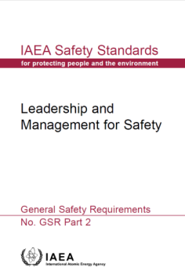
Difference between management and leadership
‘management’ is a function and
‘leadership’ is a relation.
Management ensures that work is completed in accordance with requirements, plan and resources. It is through leadership that individuals may be influenced and motivated, and organizations changed. Managers may also act as leaders.”
  Management is a formal, authorized function for ensuring that an organization operates efficiently and that work is completed in accordance with requirements, plans and resources.
  Leadership is the use of one’s capabilities and competences to give direction to individuals and groups and to influence their commitment to achieving the fundamental safety
  objective by means of shared goals, values and behaviour
  Managers at all levels need to be leaders for safety
07-18 May - 18-29 June 2018
Notes:
GSR Part 2 – Leadership and Management for Safety provides definitions of Management and Leadership

Slide 17
Difference between management and leadership
To manage means to accomplish activities and master routines, while to lead means to influence others and create shared understanding as driver for change
  Good Managers act as leaders
  Leaders are not necessarily managers
Leadership = a relationship | Management = a function
Create shared understanding as driver for change | Focus on short-term objectives and goals achievement
Define and share current and expected situations | Planning, Budgeting, Organizing, Staffing
Aligning people | Task distribution and follow-up
Motivating, influencing and inspiring | Controlling, problem Solving
Leading
Managing
SAFETY
07-18 May - 18-29 June 2018
Notes:
Conclusions drawn from a research review of severe accidents on how leadership issues relates to safety
Leaders have a major impact on safety and staff perceptions (see attributes above).
Demonstrating a real commitment that process safety is a core value;
Setting a consistent example and communicating values and expected behaviours – high visibility – actions match words, acting as role models;
Maintaining a ‘controlling mind’ and being ‘an intelligent customer’ - stepping back to assess the big risks;
Effective Safety Management Systems which is ‘not just paper’ and not ‘over bureaucratic’ - clear accountabilities;
Informed questioning and maintaining strong oversight;
Recognition of external pressure and change issues.
Leadership Core assumptions
- Leadership is distributed. That is, leadership is not solely the purview of the CEO, but can and should permeate all levels of the firm.
- Leadership is personal and developmental. There is no single way to lead. The best way to create change is to work with the particular capabilities that you have , while constantly working to improve and expand those capabilities.
- Leadership is a process to create change. Leadership is about making things happen, contingent on a context. Leaders may create change by playing a central role in the actual change process, or by creating an environment in which others are empowered to act.
- Leadership develops over time. It is through practice, reflection, following role models, feedback, and theory that we learn leadership

Slide 18
Roles and Responsibilities

Slide 19
Leadership Roles and Responsibilities
The Leader’s Role:
  Define reality: Where are we today? Plan to move forward..
  Define the vision: Where do we want to be? Vision and Mission
  Define how we will get there? Strategies for directions and Goals to achieve objective…
So how can leaders influence culture for safety?
  Leadership is not simply a process of acting or behaving, or a process of manipulating rewards. It is a process of power-based reality construction and needs to be understood in these terms.”
  To answer we need to understand what drives human behaviour on an individual and collective level
“Leaders must know what characteristics and attributes they want to see in the workplace, and what they want to achieve”
07-18 May - 18-29 June 2018

Slide 20

Leadership Roles and Responsibilities
Leadership aims at achieving commitment to goals, shared values and behaviours that influences and motivates individuals and organizations to continually improve performance
A clear policy, vision, strategy, plans and objectives should be developed and communicated frequently and consistently.
Should develop a good understanding, and communicate the beliefs that underlie the organization’s policies through their own behaviour and management practices. Leaders at all levels in the regulatory body show commitment to continuous improvement
Leaders will acknowledge that safety encompasses interactions
between individuals, technology and the organizations
ITO – The interaction between Individuals, Technology and Organization
07-18 May - 18-29 June 2018
Notes:
A clear policy, vision, strategy, plans and objectives should be developed and communicated frequently and consistently. To develop a good understanding, senior managers should communicate the beliefs that underlie the organization’s policies through their own behaviour and management practices. Leaders at all levels in the regulatory body show commitment to continuous improvement.
Goals: an aim, or desired result
Strategies: a plan of action designed to achieve a long-term or overall aim
Plans: a detailed proposal for doing or achieving something
Objectives: a thing aimed at or sought; goal
Safety policy: a course or principle of action adopted by an organization or individual
Senior management: the person who, or group of people which, directs, controls and assesses an organization at the highest level

Slide 21
Leadership Roles and Responsibilities
How do you feel about accountability for regulating safety?
Are you aware about how your regulatory body could be affected by the national energy policy?
What is regulatory body’s mandate?
Where does the regulatory body fit in the national legal system?
Who is accountable for national nuclear safety?
How are you making this happen in your country?
What do you need to do next?
  Clearly understand your role and functions
  Develop organizational configuration
  Clearly articulate goals and objectives
  Ensure the development of the management system
  Foster a strong safety culture
GSR Part 2 | Requirement 2
07-18 May - 18-29 June 2018
Notes:
Lecturer may ask the audience these questions to make them think of their roles and responsibilities for which they are accountable to public and other interested parties. In order to gain confidence of the public, government and the international organization, the leaders have to have clear understanding of their roles.
Accountability for safety: Leaders are accountable for safety as they are mandated to ensure safety for the protection of public the environment and workers from ionising radiation.
National energy policy: Leaders should know and understand the national energy policy to develop their strategic plan and goals and provide vision to the organization.
Regulatory body mandate provides to structure your organization and make available resources to fulfill the mandate
Regulatory body fits in the national legal system: To have an effective independent decision making powers
Accountable for national nuclear safety: As mandated by the government the regulatory body has to ensure the safety objectives are achieved by the operating organization
How to make it happen: Appropriate Leadership for safety by giving priority to safety in decision making process without any political or financial influence

Slide 22
Organizational Role
How is the organization structured?
How it is resourced?
How commitment to safety is realized?
How organizational culture that supports and encourages trust, collaboration, consultation and communication is influenced?
How national and international interfaces are managed? [GSR Part 1, Req.12]
How is your organization integrated with the global nuclear safety regime?
How organizational growth and change is managed? [SSG 16 | Action. 76]
Key aspects of a good leader
Set an example as role model
Provide direction, clear goals, communicate ‒ motivate, mobilise, cultivate, empower ‒ mentor, coach, foster involvement ‒ instil trust and loyalty
Recognise and reward performance
Adapt to leadership style to the demands of the situation, it takes time and leadership to put a management system in place
07-18 May - 18-29 June 2018
Notes:
Senior managers and all other managers shall advocate and support the following:
(a) A common understanding of safety and of safety culture, including:
awareness of radiation risks and hazards relating to work and to the working environment; an understanding of the significance of radiation risks and hazards for safety;
and a collective commitment to safety by teams and individuals;
(b) Acceptance by individuals of personal accountability for their attitudes and conduct with regard to safety;
(c) An organizational culture that supports and encourages trust, collaboration, consultation and communication;
(d) The reporting of problems relating to technical, human and organizational factors and reporting of any deficiencies in structures, systems and components to avoid degradation of safety, including the timely acknowledgement of, and reporting back of, actions taken;
(e) Measures to encourage a questioning and learning attitude at all levels in the organization and to discourage complacency with regard to safety;
(f) The means by which the organization seeks to enhance safety and to foster and sustain a strong safety culture, and using a systemic approach (i.e. an approach relating to the system as a whole in which the interactions between technical, human and organizational factors are duly considered);
(g) Safety oriented decision making in all activities;
(h) The exchange of ideas between, and the combination of, safety culture and security culture.

Slide 23
Vision for managing growth of and change in the organization

Slide 24
Managing Growth of and Change in the Organization
Phase 2: Action 76. The regulatory body…should develop competences in managing the growth of and change in the organization
Identify the reason for growth of and change in the organization
  To be able to regulate safety of the nuclear power plant
Change Management Policy
  Describe the philosophy, principles and fundamental factors to guide action and decision-making and give priority to safety
  Align action with vision, mission, values, goals, and strategy
  Ensure internal and external communication
How to manage the growth of and change in the organization
  Determine needs then objectives
  Establish your strategy
  Take stock on the current situation and identify the gaps
  Formulate and implement plans
  Monitor, review and improve to ensure proper management of the change and growth
07-18 May - 18-29 June 2018
Notes:
Developing and implementing management of change requires time, effort and resources, especially at an early stage when the regulatory capabilities in this area are limited. It is important that this activity be undertaken with strong senior management commitments and involvement of all line managers with ownership of the whole project.
Resistance to change at all levels of the organization may be expected and should be taken care of at an earlier stage by developing confidence and trust with the organization. Management of growth and change may impact the organization’s functions, and its way of working and managing regulatory activities. This could call managerial practices into question, leading, in turn, to resistance to change;
A lack of understanding and appropriate knowledge , skill and attitude regarding the change management program may be a challenge to identify and achieve goals;
Limitation of resources. and expertise, which may be found internally (through reallocation of resources), externally or both can be identified in the initial phase of development of the project.
Key commitments required from senior management are:
Foster a positive attitude within the organization;
Openly promote the management of growth and change in the organization at all levels and communicate that message on a regular basis;
Endorse the goals and objectives associated with the project;
Allocate adequate resources to the project;
When endorsed, support and follow-up on the project’s implementation;
Assess the progress and make decisions to resolve problems hindering the successful implementation;
Ensure internal, and if applicable, external cooperation within the organization.

Slide 25
Process Flowchart
Managing Growth of and Change in the Organization
Feedback
Determinants
Forces Initiating
Growth/Change
Organizational initiator
Change Agent
What is to be Changed?
Intervention strategies
Structure?
Organizational Processes?
Culture?
Change Process
Implementing Tactics
Implementation
Unlock–change–relock
Intervention
Participation
Persuasion
Change
Growth/Change
Results
Organizational Effectiveness
  Ref: NGT 1.1
07-18 May - 18-29 June 2018
Notes:
Change Management Process
Identify need for the change  and growth
Describes the steps to be taken to effect change
Ensures change and growth objectives are achieved
Identify external and internal drivers; including imposed changes and desired outcomes
Evaluate the options to achieve the required outcomes.
Develop plans to implement the change
Monitor and Learn from the change experience 
Monitor, review, report, adjust and improve
Determine the current state and Identify Gaps
What is the nature of the current management system and what are the requirements addressed by it?
What is the nature of the desired management system and what requirements should it address?
Identify gaps between the ‘as-is’ system and the ‘to-be’ system

Slide 26
Leadership for Safety - Continuous Improvement
Measurement, Assessment and Improvement
Requirement 14: Measurement, assessment and improvement of leadership for safety and of safety culture
“Senior management shall regularly commission assessments of leadership for safety and of safety culture in its own organization”
  Senior management shall ensure that self-assessment and independent assessment of leadership for safety be conducted at all organizational levels and for all functions using recognized experts
  The results of self-assessments and independent assessments of leadership for safety shall be communicated at all levels in the organization.
  The results of such assessments shall be acted upon to improve leadership for safety and to foster a learning attitude within the organization.
07-18 May - 18-29 June 2018
Notes:
Measurement, Assessment and Improvement
Requirement 14: Measurement, assessment and improvement of leadership for safety and of safety culture
“Senior management shall regularly commission assessments of leadership for safety and of safety culture in its own organization”
6.9. Senior management shall ensure that self-assessment of leadership for
safety and of safety culture includes assessment at all organizational levels and
for all functions in the organization. Senior management shall ensure that such
self-assessment makes use of recognized experts in the assessment of leadership
and of safety culture.
6.10. Senior management shall ensure that an independent assessment of
leadership for safety and of safety culture is conducted for enhancement of the
organizational culture for safety (i.e. the organizational culture as it relates to
safety and as it fosters a strong safety culture in the organization).
6.11. The results of self-assessments and independent assessments of leadership
for safety and of safety culture [1] shall be communicated at all levels in the
organization. The results of such assessments shall be acted upon to foster and
sustain a strong safety culture, to improve leadership for safety and to foster a
learning attitude within the organization.

Slide 27
Summary
    Leadership for safety and management for safety are to be developed together and integrated so that all individuals in an organization are involved and are committed to safety and performance
    A leader has capabilities and competences to give direction to individuals and to influence their commitment to achieving the fundamental safety objective by means of shared goals, values and behavior
    Leadership provides vision for managing growth of and change in the organization
    Senior management shall regularly perform assessments of leadership for safety and the results shall be communicated at all levels in the organization
07-18 May - 18-29 June 2018

Slide 28
Key Points
Leadership in safety matters has to be demonstrated at the highest levels in an organization .
Difference between management and leadership states ‘management’ is a function and ‘leadership’ is a relation.
To manage means to accomplish activities and master routines, while to lead means to influence others and create shared understanding as driver for change.
  Leaders take responsibility for their actions and hold others responsible for theirs.
Making major organisational growth and change requires a clear leadership competences for an effective and efficient project management
07-18 May - 18-29 June 2018

Slide 29
Questions 10-15 minutes discussion
What is the basic difference between leadership and management?
Outline difference and correlations between management and leadership?
What are the main leadership responsibilities ?
Lists some of the characteristics of leadership that improve performance.
07-18 May - 18-29 June 2018
Notes:
Review questions for 10-15 minutes discussion :
Q1. What is the basic difference between leadership and management ?
The basic difference between management and leadership can be stated simply whereby ‘management’ is a function and ‘leadership’ is a relationship.
Q2. Outline difference and correlations between management and leadership?
A. To manage means to accomplish activities and master routines, while to lead means to influence others and create shared understanding as driver for change
Management’ is a formal, authorized function for ensuring that an organization operates efficiently in accordance with requirements, plans and resources. Managers at all levels need to be leaders for safety.
While, leadership for safety has to be demonstrated at all levels in the organization by sharing values and expectations and commitment to goals, shared values and behaviors that influences and motivates individuals and organizations to continually improve performance. Thus, managers and leaders throughout an organization should set an example for safety, for example, through their direct involvement with the individuals .
Q3. What are the main leadership responsibilities ?
A. Leadership aims at achieving commitment to goals, shared values and behaviours that influences and motivates individuals and organizations to continually improve performance. A clear policy, vision, strategy, plans and objectives should be developed and communicated frequently and consistently. Leaders are responsible to develop a good understanding, and communicate the beliefs that underlie the organization’s policies through their own behaviour and management practices. Leaders at all levels in the organization show commitment to continuous improvement. Leaders acknowledge that safety encompasses interactions between individuals, technology and the organizations (ITO)
Q4. Lists some of the characteristics of leadership that improve performance.
A.
Commitment to safety by senior management
Provision of clear policy, vision, strategy, plans and objectives,
Develop effective lines of communication within the organization,
Act as role model so as to communicate the beliefs that underlie the organization’s policies through their own behaviour and management practices,
Leadership skills are systematically developed
Management assures that there is sufficient and competent staff
Leaders at all levels seek feedback on how effective the leadership is in ensuring and improving safety, and should take action as necessary,
Management has the ability to resolve conflicts as necessary
Relationships between management and staff are built on trust

Slide 30
List of abbreviations
IMS- Integrated Management System
INSAG – International Nuclear Safety Advisory Group
GSR – General Safety Requirement
GSG – General Safety Guide
SSG – Specific Safety Guide
07-18 May - 18-29 June 2018

Slide 31
References
INTERNATIONAL ATOMIC ENERGY AGENCY, Fundamental Safety Principles, Safety Standards Series No. SF-1, IAEA, Vienna (2006).
INTERNATIONAL ATOMIC ENERGY AGENCY, Governmental, Legal and Regulatory Framework for Safety, IAEA Safety Standards Series No. GSR Part 1 (Rev. 1), IAEA, Vienna (2016).
INTERNATIONAL ATOMIC ENERGY AGENCY, Safety Requirements No. GSR Part 2, Leadership and Management for Safety (2016).
INTERNATIONAL ATOMIC ENERGY AGENCY, Application of the Management System for Facilities and Activities, Safety Guide No. GS-G-3.1, IAEA, Vienna (2006).
INTERNATIONAL ATOMIC ENERGY AGENCY, The Management System for Nuclear Installations, Safety Guide No. GS-G-3.5, IAEA, Vienna (2009).
07-18 May - 18-29 June 2018

Slide 32
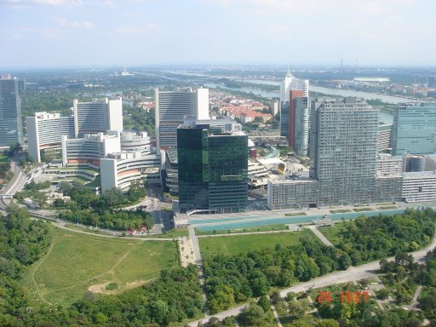
Thank you!
Notes:
Thank you!

